Slide 1


DeepLab: Semantic Image Segmentation with Deep Convolutional Nets, Atrous Convolution, and Fully Connected CRFs
(A.K.A. DeepLabv2)
J. Miguel Valverde
@jmlipman
14/02/2021
Semantic Segmentation
Source: https://pixabay.com/photos/girl-kid-coloring-colors-art-2586719/

Slide 2
The DeepLab family
DeepLabv1
DeepLabv2
DeepLabv3
DeepLabv3+
...
J. Miguel Valverde

Slide 3
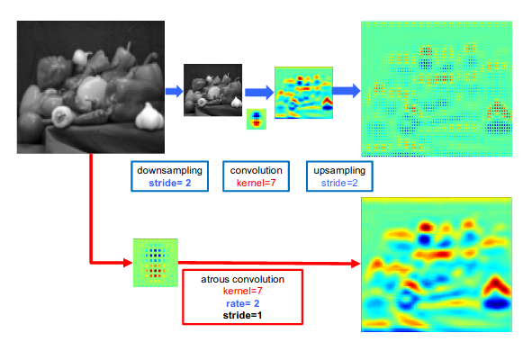
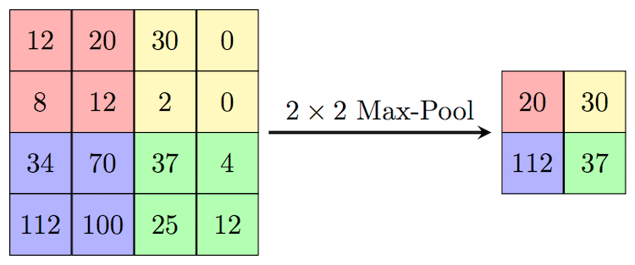
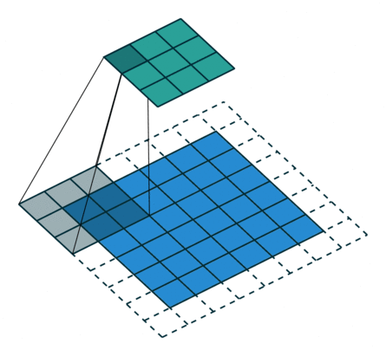
DeepLabv2 tackles three problems
Problem: Reduced feature resolution
Causes:
- Maxpooling
Source: computersciencewiki.org
- Conv, strides = 2
Source: https://github.com/vdumoulin/conv_arithmetic
J. Miguel Valverde

Slide 4
DeepLabv2 tackles three problems
Problem: Reduced feature resolution
Causes:
- Maxpooling
Source: computersciencewiki.org
- Conv, strides = 2
Source: https://github.com/vdumoulin/conv_arithmetic
J. Miguel Valverde

Slide 5
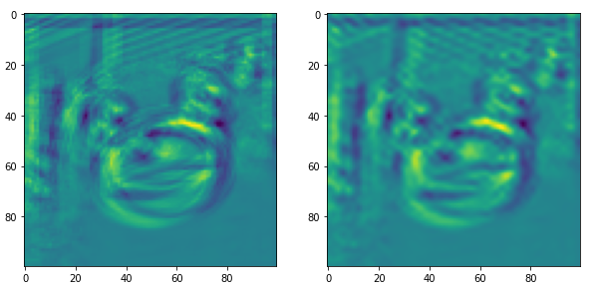
DeepLabv2 tackles three problems
Problem: Reduced feature resolution
Atrous conv. Regular conv.
J. Miguel Valverde

Slide 6
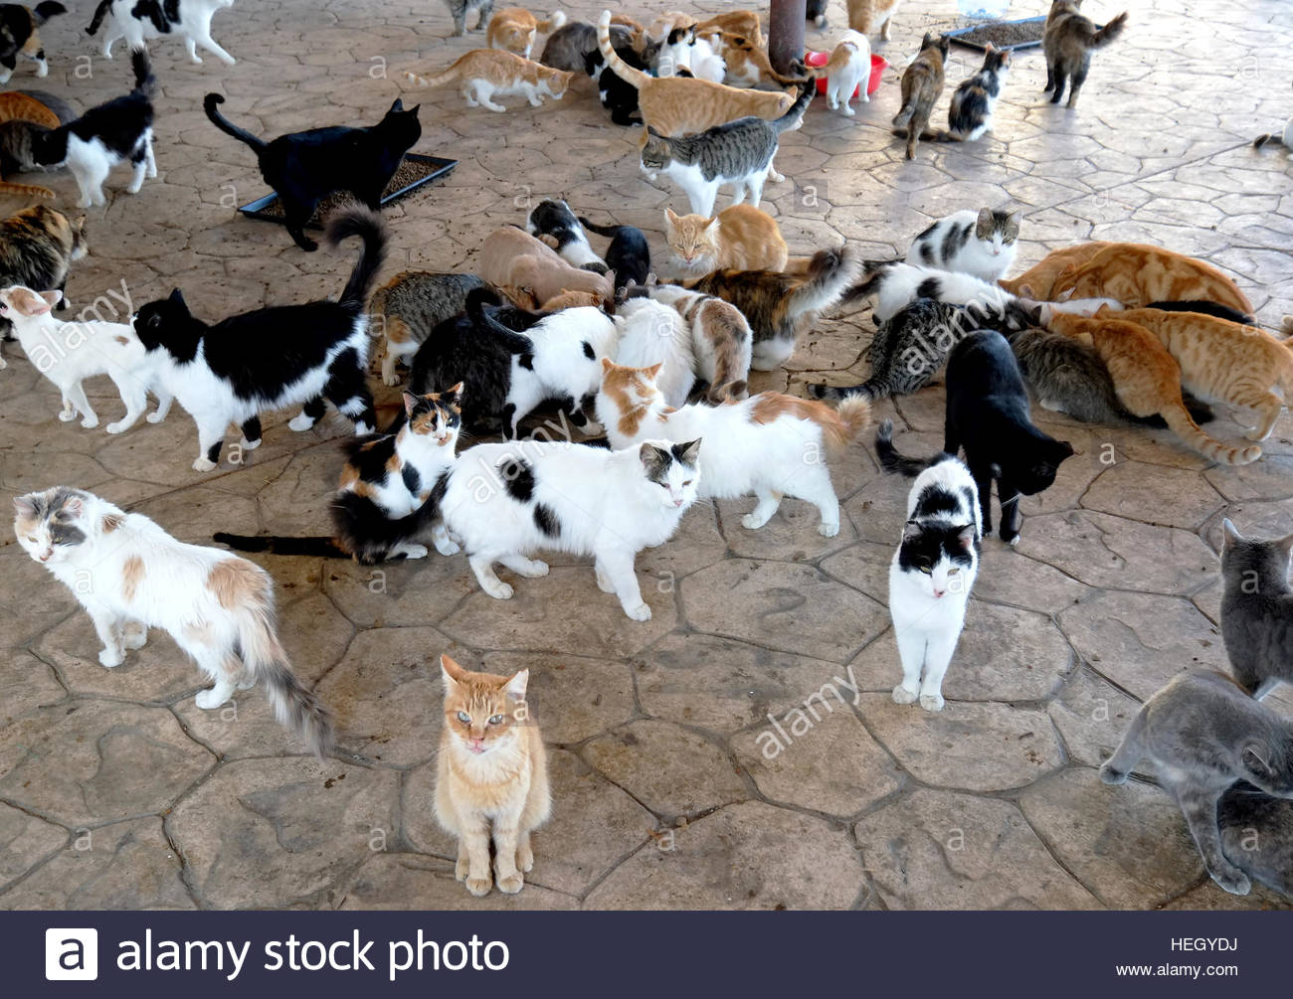
DeepLabv2 tackles three problems
2) Problem: Existence of multiple-scale objects
Same class
Different size (FoV)
J. Miguel Valverde

Slide 7
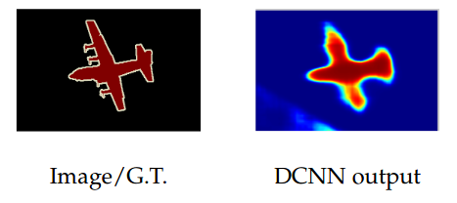
DeepLabv2 tackles three problems
3) Reduced accuracy (in borders)
J. Miguel Valverde

Slide 8
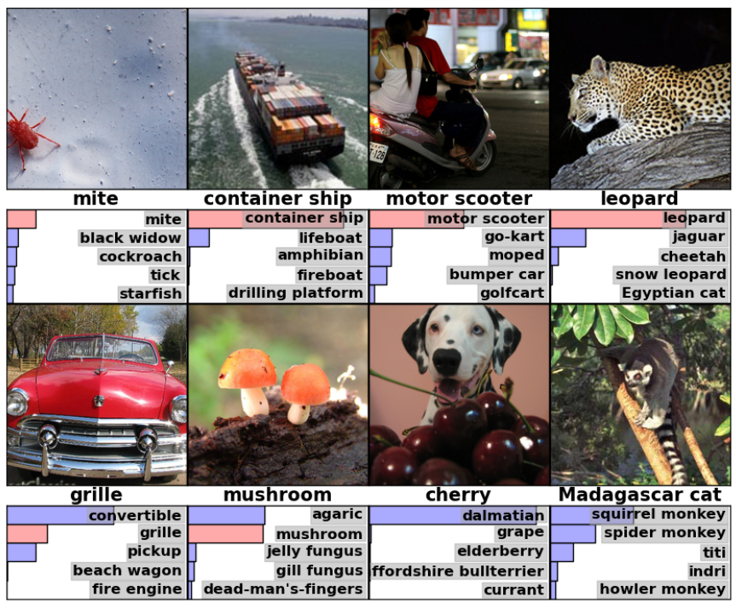
DeepLabv2 tackles three problems
Cause:
Downsampling, maxpooling, useful to achieve invariance in classification
3) Reduced accuracy (in borders)
In Segmentation we want to preserve spatial information
J. Miguel Valverde

Slide 9
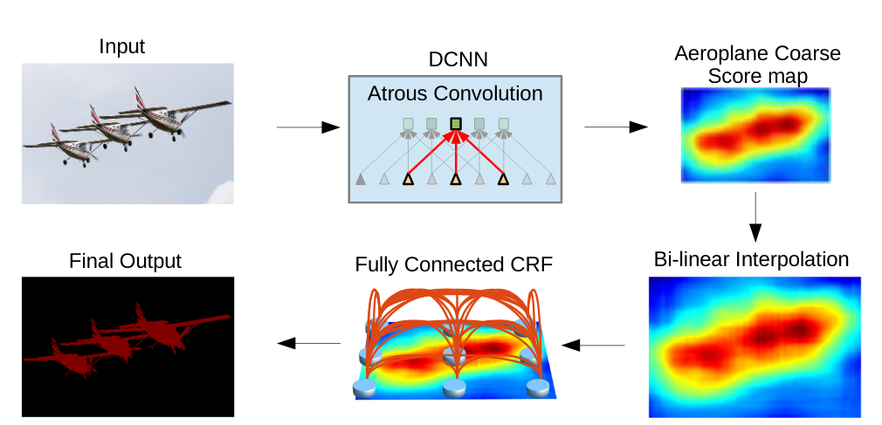
DeepLabv2 proposes three methods
1) Atrous convolution (or dilated convolution)
2) Atrous Spatial Pyramid Pooling (ASPP)
3) Conditional Random Fields (CRFs)
Pipeline
Backbone
ASPP
Upsample x8
CRF
J. Miguel Valverde

Slide 10


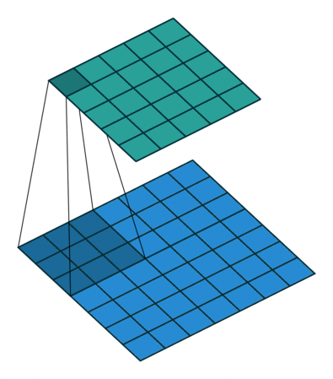
DeepLabv2 proposes three methods
1) Atrous convolution (or dilated convolution)
Filter = 3x3 → Increases the field of view.
Dilated Regular
J. Miguel Valverde

Slide 11
DeepLabv2 proposes three methods
1) Atrous convolution (or dilated convolution)
Filter = 3x3 → Increases the field of view.
Dilated Regular
J. Miguel Valverde

Slide 12
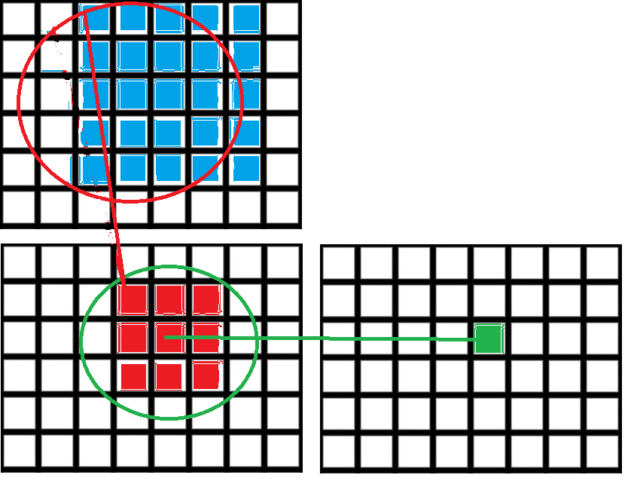
DeepLabv2 proposes three methods
(Field of view, reminder)
Operation | Field of view (size)
Conv 3x3 | 3
J. Miguel Valverde

Slide 13
DeepLabv2 proposes three methods
(Field of view, reminder)
Operation | Field of view (size)
Conv 3x3 | 3
Conv 3x3 | 3 + 2 = 5
... | ...
J. Miguel Valverde

Slide 14
DeepLabv2 proposes three methods
1) Atrous convolution (or dilated convolution)
Filter = 3x3
Same # of params
Same amount of computation
Adjust FoV with `rate`
Dilated Regular
J. Miguel Valverde

Slide 15
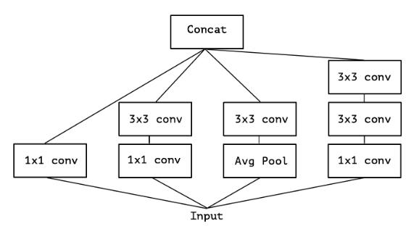
DeepLabv2 proposes three methods
2) Atrous Spatial Pyramid Pooling (ASPP)
Conv
Conv
Conv
Conv
Inceptionv3
Conv Conv Conv
Conv
Conv
...
FoV: 1 3 3 5
J. Miguel Valverde

Slide 16
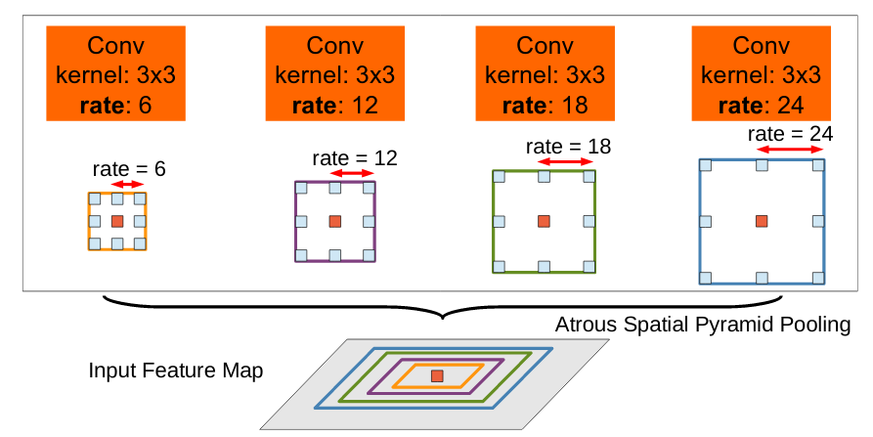
DeepLabv2 proposes three methods
2) Atrous Spatial Pyramid Pooling (ASPP)
J. Miguel Valverde

Slide 17
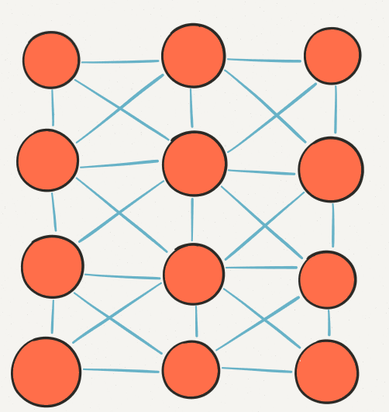
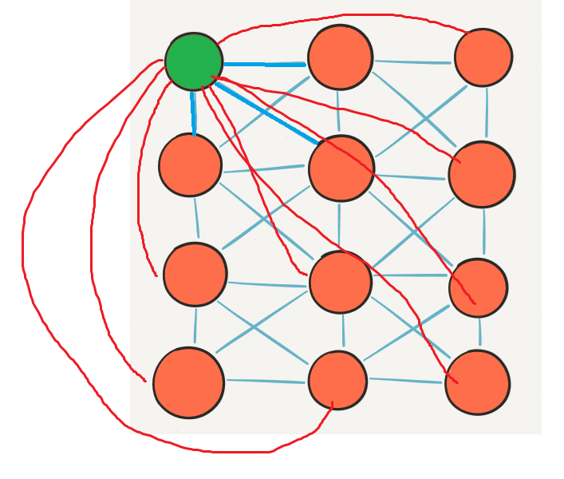
DeepLabv2 proposes three methods
3) Conditional Random Fields (CRFs)
Image → Graph
Short-range / local CRFs
Fully-connected CRFs
Source: http://www.jonathanfischer.net/lets-build-gameplaykit-grid-pathfinding/
J. Miguel Valverde

Slide 18
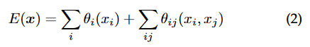
DeepLabv2 proposes three methods
3) Conditional Random Fields (CRFs)
CNN
J. Miguel Valverde

Slide 19
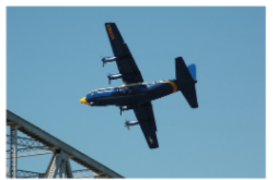
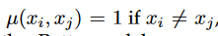
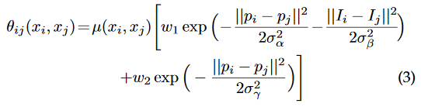
DeepLabv2 proposes three methods
3) Conditional Random Fields (CRFs)
p = coordinates
I = RGB intensity values
J. Miguel Valverde

Slide 20
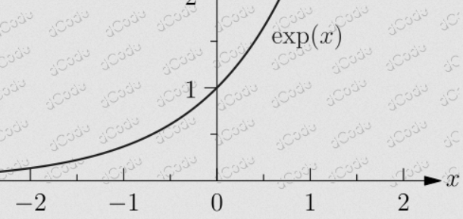
DeepLabv2 proposes three methods
3) Conditional Random Fields (CRFs)
Always positive
J. Miguel Valverde

Slide 21
DeepLabv2 proposes three methods
3) Conditional Random Fields (CRFs)
Always positive
Always negative
J. Miguel Valverde

Slide 22
DeepLabv2 proposes three methods
3) Conditional Random Fields (CRFs)
Always positive
Always negative
J. Miguel Valverde

Slide 23
DeepLabv2 proposes three methods
3) Conditional Random Fields (CRFs)
Small distance, similar intensities
J. Miguel Valverde

Slide 24
DeepLabv2 proposes three methods
3) Conditional Random Fields (CRFs)
Small distance, similar intensities
Small negative values → large penalty
J. Miguel Valverde

Slide 25
DeepLabv2 proposes three methods
3) Conditional Random Fields (CRFs)
Small distance, similar intensities
Small negative values → large penalty
But such penalty → only if labels are different!
J. Miguel Valverde

Slide 26
DeepLabv2 proposes three methods
3) Conditional Random Fields (CRFs)
Large distance, different intensities
J. Miguel Valverde

Slide 27
DeepLabv2 proposes three methods
3) Conditional Random Fields (CRFs)
Large distance, different intensities
Large negative values → very small penalty
J. Miguel Valverde

Slide 28
Experiments
Learning rate policy
vs. decreasing with a fixed step size
J. Miguel Valverde

Slide 29
Experiments
Learning rate policy
vs. decreasing with a fixed step size
Different FoV in the ASPP
Larger → Better
J. Miguel Valverde

Slide 30
Experiments
Different architectures
ResNet-101 > VGG-16
CRFs
With > Without
J. Miguel Valverde

Slide 31

The code!
J. Miguel Valverde

Slide 32
The original ideas were old
1) Atrous convolution (or dilated convolution)
1989
2) Atrous Spatial Pyramid Pooling (ASPP)
2014
3) Conditional Random Fields (CRFs)
2001
DeepLabv2 paper: 2017
J. Miguel Valverde

Slide 33
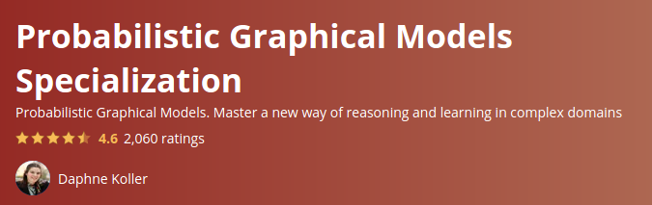
Do you want to learn more about CRFs?
Original work
“Conditional Random Fields: Probabilistic Models for Segmenting and Labeling Sequence Data”. J. Lafferty et al. (2001)
Great introduction
“An Introduction to Conditional Random Fields”. C. Sutton and A. McCallum (2011) https://homepages.inf.ed.ac.uk/csutton/publications/crftut-fnt.pdf
Coursera course
J. Miguel Valverde

